Slide 1


E D U C A T I O N A L P S Y C H O L O G Y S E R V I C E
Difficult to engage pupils
June 2015
Sarah Vickers
Behaviour Support and Emotional Well-Being Coordinator
Scott I-Patrick
Trainee Educational Psychologist
Notes:
What materials do we need?
Flipchart and stand or whiteboard
Marker pens for SV & SI-P
Paper and pens for participants
Space for pairs and small-group work
Any handouts for workshop

Slide 2


E D U C A T I O N A L P S Y C H O L O G Y S E R V I C E
I am a skilled ELSA with bags of strategies which I can’t use because he just won’t engage...
She is already fed up…just like the others

Slide 3

E D U C A T I O N A L P S Y C H O L O G Y S E R V I C E
Why might children prove difficult to engage?
Notes:
Focus on emotional … what is your focus…

Slide 4
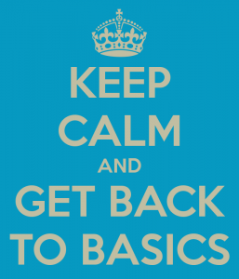

E D U C A T I O N A L P S Y C H O L O G Y S E R V I C E
What is my primary role as an ELSA?

Slide 5

E D U C A T I O N A L P S Y C H O L O G Y S E R V I C E
What do ELSAs do?
Help children to learn and practice social and emotional skills
Help children to feel valued and listened to
Advocate for children in school
Advocate for emotional literacy in school
Notes:
Get delegates to spend a couple of minutes discussing among themselves which of the 4 listed roles they feel is most important

Slide 6

E D U C A T I O N A L P S Y C H O L O G Y S E R V I C E
Help children to learn and practice social and emotional skills
Skills aim
Help children to feel valued and listened to
Therapeutic aim

Slide 7
E D U C A T I O N A L P S Y C H O L O G Y S E R V I C E
If the therapeutic aims are not achieved, it will be almost impossible to achieve the skills aims
The key factor which determines whether therapeutic aims are achieved is the quality of the relationship between the ELSA and the pupil
Notes:
This suggest that the most important element an ELSA brings to a situation is not how much strategies they have or how skilled they are in delivering interventions and achieving solutions, but their ability to develop rapport with the pupils they work with.
If you are unable to develop the degree of rapport in your relationship with pupils, your insights and suggestions will not be heard, or acted upon, and will consequently have little influence.

Slide 8
E D U C A T I O N A L P S Y C H O L O G Y S E R V I C E
Clients trust in their therapist is the most important thing in successful work
Strupp and colleagues (1969)
“This faith in the integrity of the therapist may be called the capstone of a successful therapeutic relationship, subsuming other characteristics”
(p.36)

Slide 9

E D U C A T I O N A L P S Y C H O L O G Y S E R V I C E
ELSAs have limited time to build/ form relationships so having the skills that help to enhance speedy development of ‘rapport’ is crucial
Notes:
Effective communicators establish rapport naturally in any situation. It is easy to establish rapport naturally with a pupils that are willing to engage but not so easy with difficult to engage pupils.
The remaining part of the workshop will provide you with an opportunity to consider key rapport-building skills
and to practise them.

Slide 10

E D U C A T I O N A L P S Y C H O L O G Y S E R V I C E
Looking at developing some quick rapport building skills
But first, a look at why this is necessary in the first place
Notes:
Rapport is the ability to relate to others in a way that creates a level of trust and understanding. It is the process of responsiveness at the unconscious level. It is important to build rapport with your client/colleague as it gets there unconscious mind to accept and begin to process your suggestions. They are made to feel comfortable and relaxed-open to suggestions.
Rapport is one of the most important features or characteristics of unconscious human interaction. It is commonality of perspective, being in "sync", being on the same "wavelength" as the person with whom you are talking. There are a number of techniques that are supposed to be beneficial in building rapport such as: matching your body language (ie, posture, gesture, and so forth); maintaining eye contact; and matching breathing rhythm.
20 minutes for slide 1 – 9 (or less, agree with Sarah Vickers)
Plan for remaining time (40 minutes):
● Introduction: Brief talk about intersubjective experience: 5 minutes
● An introduction to building rapport: 10 minutes
● Pacing and leading – exercise: 10 minutes
● Group discussion :10 minutes
● Summary and close: 5 minutes
Rapport is a congruent communication from one person to another that they appreciate the other’s situation and thoughts and understand their point of view. This communicated both verbally and non verbally, and there must be congruence in these elements of the communication

Slide 11
E D U C A T I O N A L P S Y C H O L O G Y S E R V I C E
Rapport starts with
Pupil
ELSA
Intersubjective
Experience
Intersubjective
Experience
Shared
meaning
Pupil’s beliefs,
Values,
sense of –
personal identity
ELSA’s beliefs,
Values,
sense of –
personal identity
Achieved through
Language, gestures
& vocalisations
Understanding of
How things &
People behave
Understanding of
How things &
People behave
Notes:
Intersubjective experience: Understanding of the world and everything in it including ourselves
Built on individually constructed model of the world
Based on experiences we have encountered in life
Represents all the rules and understandings we have inferred about the way the world works
We can’t experience some one else’s model of the world or have them experience our model of the world.
In attempting to communicate we have to put our internal subjective experience into communicable form…
The recipient of the communication has to interpret the behavioural and language based communication within the context of their own model of the world to infer the meaning of the communication.
In this sense, there is a value in being able to communicate effectively both non-verbally as well as with spoken language.
In developing rapport, our aim is to use our communication skills effectively to communicate a sharing of our models of the world.

Slide 12
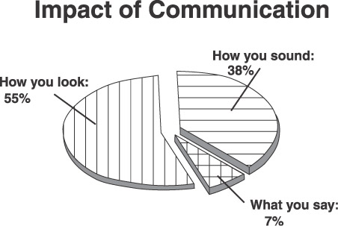
E D U C A T I O N A L P S Y C H O L O G Y S E R V I C E
Different elements of communication
(Mehrabian 1972)
Notes:
Given that behavior in the form of communication reflects a person’s model of the world, we can demonstrate a shared perception of the world through matching different elements of communication directly
This matching of communication is particularly effective in relation to the non-language elements of behavior, as these tend to be less in conscious awareness than the language elements

Slide 13


E D U C A T I O N A L P S Y C H O L O G Y S E R V I C E
Share with the group what you know of rapport building skills
Notes:
Do not note them down, just acknowledge them as they are
offered. Skills mentioned may include:
● mirroring
● matching
● pacing and leading
● eye contact
● body language
● representational systems
● accessing cues.
If they want to know what these are, get participants to tell each other what they currently understand of these skills

Slide 14

E D U C A T I O N A L P S Y C H O L O G Y S E R V I C E
Workshop will focus on…
Mirroring/ Matching
Pacing and leading
Notes:
Go to Handout
Pacing and leading are the key concepts for a systematic means of building rapport –
Pacing is the process of matching over time , that is communicating the recognition and respect for the other person and their model of the world
By giving a subtle match of their communications verbally and particularly non verbally, the message of commonality, or appreciation of the others model of the world is conveyed.
Pacing is a two-way process… leading is the other face – interchangeable
After Handout, demonstrate with Sarah….

Slide 15
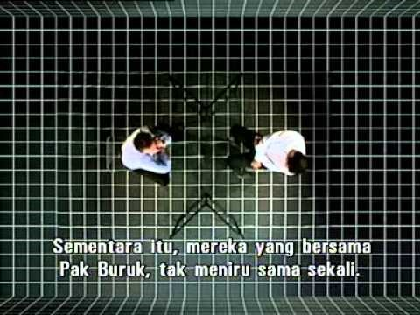
E D U C A T I O N A L P S Y C H O L O G Y S E R V I C E
Notes:
Go to Handout
Pacing and leading are the key concepts for a systematic means of building rapport –
Pacing is the process of matching over time , that is communicating the recognition and respect for the other person and their model of the world
By giving a subtle match of their communications verbally and particularly non verbally, the message of commonality, or appreciation of the others model of the world is conveyed.
Pacing is a two-way process… leading is the other face – interchangeable
After Handout, demonstrate with Sarah….

Slide 16

E D U C A T I O N A L P S Y C H O L O G Y S E R V I C E
Notes:
Go to Handout
Pacing and leading are the key concepts for a systematic means of building rapport –
Pacing is the process of matching over time , that is communicating the recognition and respect for the other person and their model of the world
By giving a subtle match of their communications verbally and particularly non verbally, the message of commonality, or appreciation of the others model of the world is conveyed.
Pacing is a two-way process… leading is the other face – interchangeable
After Handout, demonstrate with Sarah….

Slide 17
E D U C A T I O N A L P S Y C H O L O G Y S E R V I C E
Activity
Each of you have been handed a piece of paper with different roles. Please team up with someone with a different role to yours to form a group of 3 – ELSA, Pupil, Observer.
The aim of the activity is for the ELSA to use the skills of Mirroring/ Matching, and Pacing and Leading to build rapport with a pupil who is reluctant to engage.

Slide 18
E D U C A T I O N A L P S Y C H O L O G Y S E R V I C E
Group Discussion
How did it go?
What do you need to do to develop these skills?
How do you think you will be able to use these skills?
Notes:
Summary,
We all match naturally those we know well, we can develop these skills to use with we do not know well.
We can practice throughout life, during the rest of this workshop, we can effectively lead someone from not wanting to engage with us to telling us things they would not have told anyone
It is an important skill to have available.
Give 5 mins.

Slide 19
E D U C A T I O N A L P S Y C H O L O G Y S E R V I C E
Thank you

